Slide 1
EECS 370
Lab 3:
ARM Assembly

Slide 2
Upcoming Assignments
Homework 1 due Monday Sept 22
Project 1s & 1m due Thursday Sept 18

Slide 3
This Lab Will Cover:
ARM LEGv8 Assembly
Memory and Struct Alignment

Slide 4
LC2K Instructions Compared to ARM
cheat sheet!
LC2K | ARM | Differences
add (R-type) | ADD | Also ADDI for constants, and SUB/SUBI for subtraction. (LC2K Subtraction: nor the 2nd with itself, add 1, add result to 1st one). MOVZ #0 zeros out reg. We use LSL, LSR for shifts. (Pseudo-instructions: MUL)
nor (R-type) | Load #-1 then EOR/SUB | Much easier to use ORR/ORRI, AND/ANDI, EOR/EORI. (Note: a NOT instruction exists in pseudocode for ARM overall, but not LEGv8)
lw (I-type) | LDURSW | This is for 32 bits. Also LDUR, LDURH, LDURB.
sw (I-type) | STURW | This is for 32 bits. Also STUR, STURH, STURB.
beq (I-type) | CMP then B.EQ | CBZ branch if zero (beq 0 regB offset), B for unconditional (beq 0 0 offset)
jalr (J-type) | BR (branch reg) | Using BL with #0 right before BR stores return address
halt (O-type) | End of file
noop (O-type) | NOP | Technically not in LEGv8, but present in ARM overall
Notes:
Instructors - no need to go over anything here specifically

Slide 5
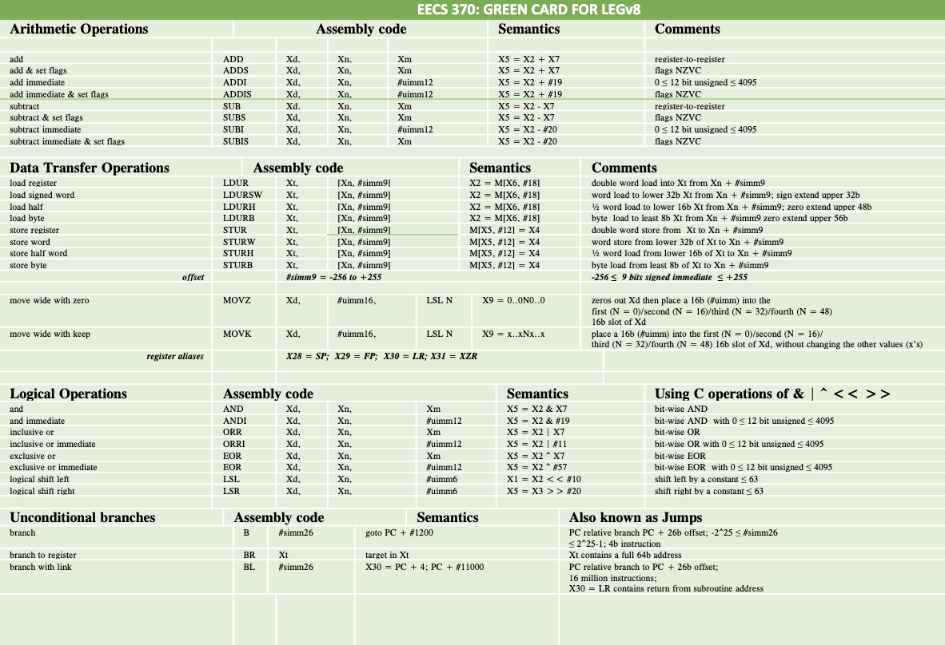
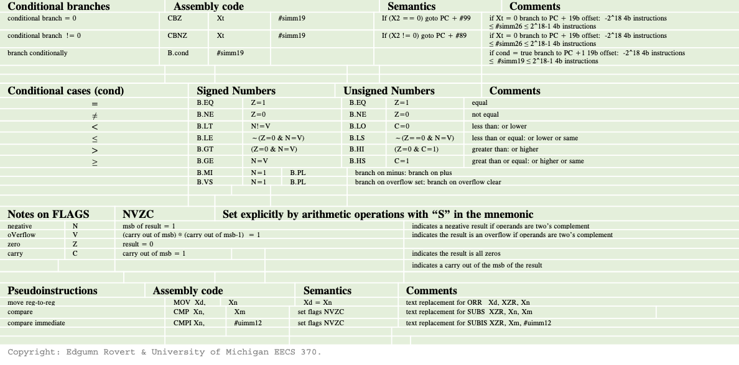
ARM LEGv8 Reference Card
See the ARM LEGv8 reference card for a helpful overview of important LEGv8 instructions.
This can be found in the website under “References Material” in the “Course Resources” section.

Slide 6
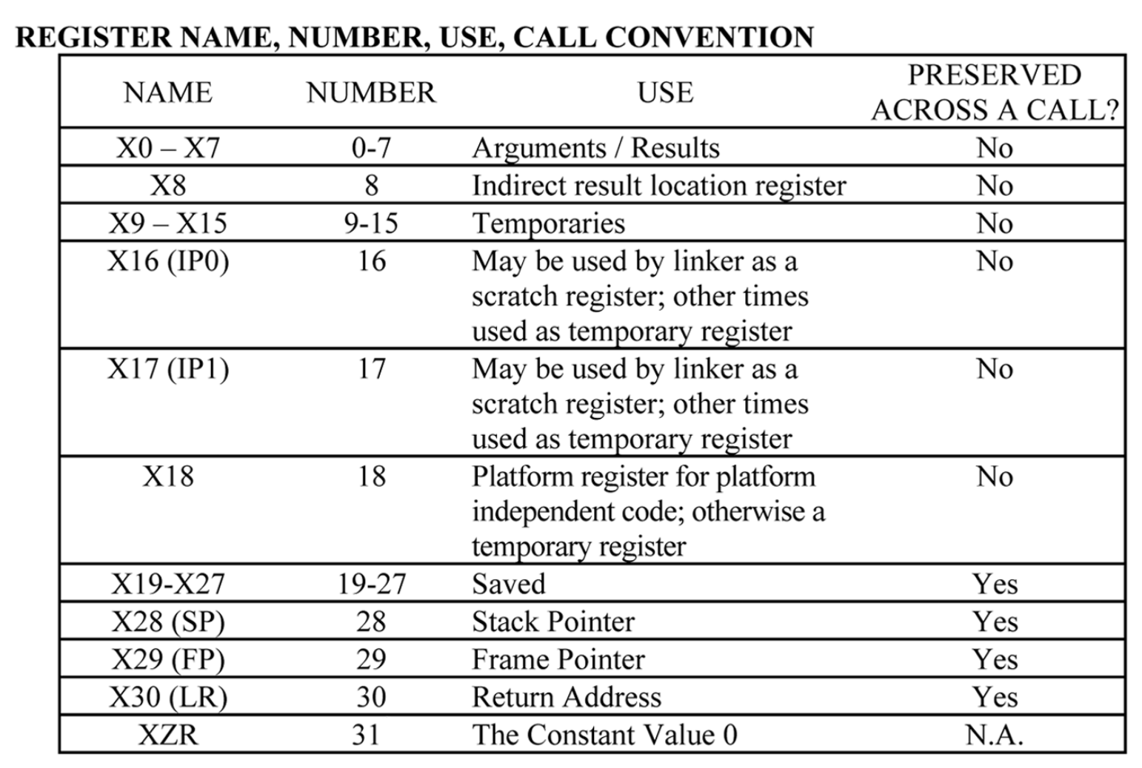
ARM LEGv8 ABI
Application Binary Interface (ABI) defines the convention of how registers should be used
Ex: LEGv8 Register X0-X7 are used
for arguments/results
Snippet shown here

Slide 7
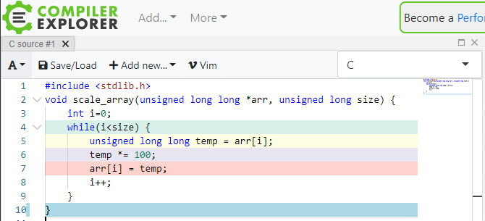
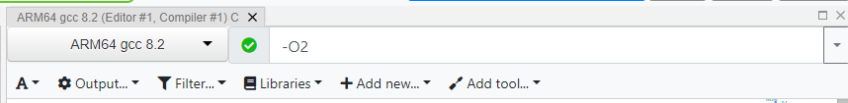
Problem 1 & 2
Introduce yourself to your group
Go to godbolt.org
Write code into source tab
Select "carm64g820” or “ARM64 gcc 8.2" for the architecture and "-O2" for the compiler options
Read the code and walk through how it multiplies without a multiply instruction
Notes:
Target around 20 minutes for groups to work on this

Slide 8
This Lab Will Cover:
ARM LEGv8 Assembly
Memory and Struct Alignment

Slide 9




Data is Stored in Memory in Chunks
Each chunk is (typically) the size of a single byte
Think of each chunk like a wooden letter block:
To interpret the word, we can rearrange the blocks, but can’t change the letters.

Slide 10
Endianness in Byte-Addressable Systems
32-bit Integer
Big Endian Memory
0xBAADF00D
Little Endian Memory
addr | BA
addr+1 | AD
addr+2 | F0
addr+3 | 0D
0D | addr
F0 | addr+1
AD | addr+2
BA | addr+3
Big Endian builds the word so the smallest address is the MSB.
This can be more natural for humans to think about.
Little Endian builds the word so the largest address is the MSB.
Faster for a computer to read, as int ops can start after reading the first byte.

Slide 11
Memory Alignment
In memory, data is aligned to the size of its type
This makes it more efficient to access within memory
and is important for caching (we’ll see why later in the course)
4-bytes, needs to start
on a multiple of 4
0 | 1 | 2 | 3 | 4 | 5 | 6 | 7
0 | 1 | 2 | 3 | 4 | 5 | 6 | 7
0 | 1 | 2 | 3 | 4 | 5 | 6 | 7
0 | 1 | 2 | 3 | 4 | 5 | 6 | 7

Slide 12
Typical Size of Data Types
cheat sheet!
Data Type | Size / Alignment
char | 1 Byte
short | 2 Bytes
int, float | 4 Bytes
double | 8 Bytes
long (32-bit Architecture) | 4 Bytes
long (64-bit Architecture) | 8 Bytes
pointer (32-bit Architecture) | 4 Bytes
pointer (64-bit Architecture) | 8 Bytes

Slide 13
Aligning Data within a struct
Since a struct can contain multiple different data types,
we must align the struct using the largest primitive type within it
Furthermore, we may need to pad the struct to keep everything aligned,
even padding the end in case we have an array of structs
Raw Data
0 | 1 | 2 | 3 | 4 | 5 | 6 | 7 | 8 | 9 | 10 | 11 | 12 | 13 | 14 | 15
Data in struct
Notice the padding
Notes:
Walk through the placement of each block verbally

Slide 14
Example: Addressing Data in Memory
Determine the start and end addresses for the following variables. (Assume a 64-bit system and that the data starts on address 200₁₀ )
struct {
short a;
int b;
char c;
int* d;
struct {
int e;
char f [10];
} g;
} example;
a: 200 - 201
b: 204 - 207
c: 208 - 208
d: 216 - 223
e: 224 - 227
f: 228 - 237
g: 224 - 239
total: 200 - 239 ➝ 40 bytes

Slide 15
Visual Walkthrough
Address
200
201
202
203
204
205
206
207
struct {
short a;
int b;
char c;
int* d;
struct {
int e;
char f [10];
} g;
} example;

Slide 16
Visual Walkthrough
Address
200
201
202
203
204
205
206
207
struct {
short a;
int b;
char c;
int* d;
struct {
int e;
char f [10];
} g;
} example;

Slide 17
Visual Walkthrough
Address
200
201
202
203
204
205
206
207
struct {
short a;
int b;
char c;
int* d;
struct {
int e;
char f [10];
} g;
} example;

Slide 18
Visual Walkthrough
Address
208
209
210
211
212
213
214
215
struct {
short a;
int b;
char c;
int* d;
struct {
int e;
char f [10];
} g;
} example;

Slide 19
Visual Walkthrough
Address
216
217
218
219
220
221
222
223
struct {
short a;
int b;
char c;
int* d;
struct {
int e;
char f [10];
} g;
} example;

Slide 20
Visual Walkthrough
Address
224
225
226
227
228
229
230
231
struct {
short a;
int b;
char c;
int* d;
struct {
int e;
char f [10];
} g; //Align with e
} example;
int e must start where struct g starts

Slide 21
Visual Walkthrough
Address
224
225
226
227
228
229
230
231
struct {
short a;
int b;
char c;
int* d;
struct {
int e;
char f [10];
} g; //Align with e
} example;

Slide 22
Visual Walkthrough
Address
224
225
226
227
228
229
230
231
struct {
short a;
int b;
char c;
int* d;
struct {
int e;
char f [10];
} g; //Align with e
} example;

Slide 23
Visual Walkthrough
Address
232
233
234
235
236
237
238
239
struct {
short a;
int b;
char c;
int* d;
struct {
int e;
char f [10];
} g; //Align with e
} example;//Align with d

Slide 24
Visual Walkthrough
Address
232
233
234
235
236
237
238
239
struct {
short a;
int b;
char c;
int* d;
struct {
int e;
char f [10];
} g; //Align with e
} example;//Align with d
struct g ends on multiple of 4

Slide 25
Visual Walkthrough
Address
232
233
234
235
236
237
238
239
struct {
short a;
int b;
char c;
int* d;
struct {
int e;
char f [10];
} g; //Align with e
} example;//Align with d
struct example ends on multiple of 8

Slide 26
Grid View
struct {
short a;
int b;
char c;
int* d;
struct {
int e;
char f [10];
} g;
} example;
offset | +0 | +1 | +2 | +3 | +4 | +5 | +6 | +7
base | a | a |  |  | b | b | b | b
+8 | c
+16 | d | d | d | d | d | d | d | d
+24 | e | e | e | e | f | f | f | f
+32 | f | f | f | f | f | f | g | g

Slide 27
Struct Memory Optimization (281 Tip)
We can rearrange the variables in a struct to use as little padding as possible for BOTH 32-bit and 64-bit systems.
Greedy yet optimal algorithm: start with the largest size primitives, then go down.
  This also works by starting with the smallest, and working up.
  And there might be more solutions for a given struct.
Count structs as multiples of their largest member, as with alignment.

Slide 28
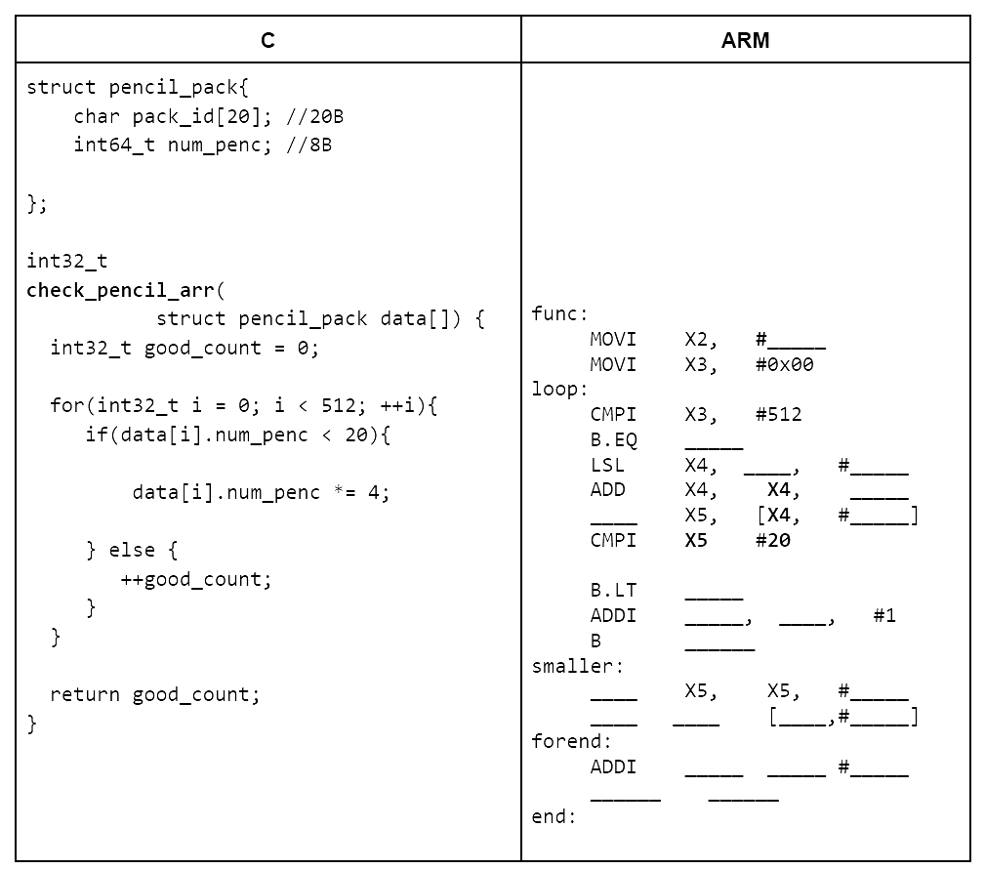
Problem 3
Complete the C to ARM translation

Slide 29
Extra Example

Slide 30
Putting It All Together: C → ARM Example
We will be writing a basic ARM LEGv8 program that accomplishes the following snippet of C code. Assume the starting address of the array arr is stored in register X0 and index i is stored in register X1.
struct point {
int8_t x; // 1B
int8_t y; // 1B
}
void foo(point arr[], int i) {
arr[i].x += 5;
}

Slide 31

Is this code correct?
Take some time to examine the assembly code.
Starting address of arr: X0. Index i: X1.
struct point {
int8_t x; // 1B
int8_t y; // 1B
}
foo:
ADD X2, X0, X1
LDURB X3, [X2, #0]
ADDI X3, X3, #5
STURB X3, [X2, #0]
end:
...
void foo(point arr[], int i) {
arr[i].x += 5;
}
This won’t work!!
Let’s see why in the next slide!

Slide 32
Assume i = 2. What goes wrong?
struct point {
int8_t x; // 1B
int8_t y; // 1B
}
Starting address of arr: X0. Index i: X1.
foo:
ADD X3, X0, X1
LDURB X4, [X3, #0]
ADDI X4, X4, #5
STURB X4, [X3, #0]
void foo(point arr[], int i) {
arr[i].x += 5;
}
+[X1]
[X0]
[X3]
We wanted to load arr[2].x!! Brainstorm what went wrong!
+i = +2
offset | +0 | +1 | +2 | +3 | +4 | +5 | +6 | +7
base | arr[0].x | arr[0].y | arr[1].x | arr[1].y | arr[2].x | arr[2].y | arr[3].x | arr[3].y

Slide 33
What should we have done?
struct point {
int8_t x; // 1B
int8_t y; // 1B
}
point is 2 bytes and LEGv8 is byte-addressable!
So, to traverse an array of point’s, we must traverse by 2 bytes at a time!
void foo(point arr[], int i) {
arr[i].x += 5;
}
+[X1]
What are some ways to multiply by 2?
[X0]
[X3]
+(i*2) = +4
offset | +0 | +1 | +2 | +3 | +4 | +5 | +6 | +7
base | arr[0].x | arr[0].y | arr[1].x | arr[1].y | arr[2].x | arr[2].y | arr[3].x | arr[3].y

Slide 34
Fixing our Code - Solution
struct point {
int8_t x; // 1B
int8_t y; // 1B
}
Starting address of arr: X0. Index i: X1.
foo:
LSL X2, X1, #1
ADD X3, X0, X2
LDURB X4, [X3, #0]
ADDI X4, X4, #5
STURB X4, [X3, #0]
void foo(point arr[], int i) {
arr[i].x += 5;
}
+[X2]
[X0]
[X3]
+(i*2) = +4
Final Note: Make sure to choose the right LD/ST size for the data you are handling!
offset | +0 | +1 | +2 | +3 | +4 | +5 | +6 | +7
base | arr[0].x | arr[0].y | arr[1].x | arr[1].y | arr[2].x | arr[2].y | arr[3].x | arr[3].y

Slide 35
EECS 370
Lab 3:
ARM Assembly

